Slide 1

Multiple Testing and False Discovery Rates
Motivating Example, Email
Reminder of Statistical Hypothesis Testing
Multiple Testing and Error Rates
Microarray example of Multiple Testing
Exercise: some fictional microarray p-values for candidate genes
Basis of FDR estimation
Genstat procedure for FDR estimation, using data from 4
Exercises: sets of p-values to be used with the Genstat procedure or other software
Summary of Related Jargon
Jim McNicol & Graham Horgan, BioSS, 2006

Slide 2
Motivating example: spam filtering
Spam filters aim to separate the junk from the real email.
They get it right most of the time but sometimes filter out email you want and sometimes let junk through.
Hypothesis: Ho: email is okay
Ha: email is spam
Decision: Do: email is okay
Da: email is spam

Slide 3
Spam filtering: what happens
Applying the Filter
1000 academic emails: Filter identified 100 spams.
All 1000 emails were later examined individually with the following results:
Decision
Do Da
Truth Ho:OK 850 20
Ha:Spam alert 50 80
Among the 100 spam alerts 20 were False Positives.
Pr (Ho|Da) = 20/100 or 20%.
This is the False Discovery Rate.

Slide 4
Statistical testing in science
Is there really an effect?
Effect might mean treatment effect, group difference, change over time, association between measurements ….
Hypotheses: Ho (usually that there is no effect)
Ha alternative hypothesis
Also decisions: Do and Da
The decision can be right or wrong

Slide 5
DECISION
Do
Da
×
☺
TRUTH
Ho
×
☺
Ha

Slide 6
DECISION
Do
Da
×
☺
Type I
TRUTH
Ho
False positive
×
Type II
☺
Ha
False negative

Slide 7
DECISION
Do
Da
×
Type I
☺
5%
TRUTH
Ho
False positive
×
Type II
☺
Power
Ha
False negative

Slide 8
What is a p-value?
Question: How likely are the data if Ho were true?
Answer: p-value
If p is small, we will decide Da. The smaller the p-value cut-off we use, the less likely that we make a false positive error.

Slide 9
Example 1: microarrays
Find genes differentially expressed between two tumour types (BRCA1 & BRCA2)
7 and 8 arrays per type
Simple t-test to get p-value for each gene
Also calculated FDR (false discovery rate)
How? See later

Slide 10
FDR vs. p-value
p_value Inference Rates (Uniform+Beta Fit)
100
90
80
70
60
Probability (%)
50
40
30
20
10
FDR
0
FRR
0
10
20
30
40
50
60
70
80
90
100
Significance (%)
Power

Slide 12
How is FDR obtained?
We are doing lots of tests, to see which genes, protein spots, metabolites or whatever are affected.
Some are not affected (true negatives)
Some are affected (true positives)
We get p-values for all of them.
What will be the distribution of the p-values?

Slide 13
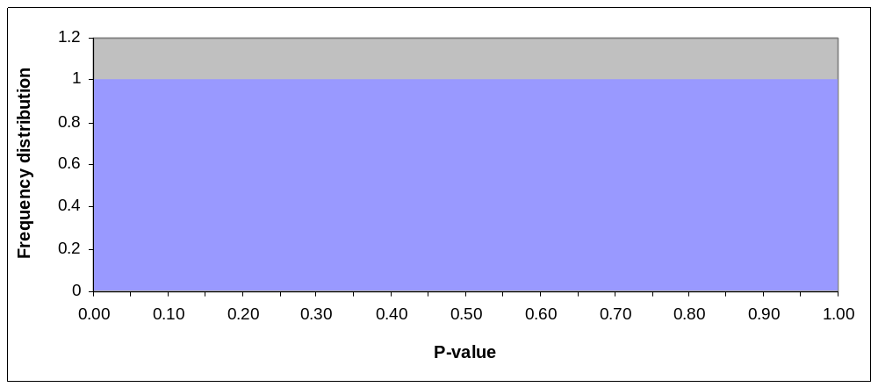
For the true negatives

Slide 14
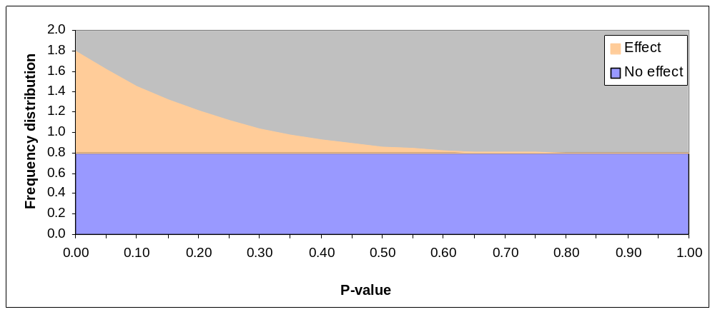
If there are some true positives

Slide 15
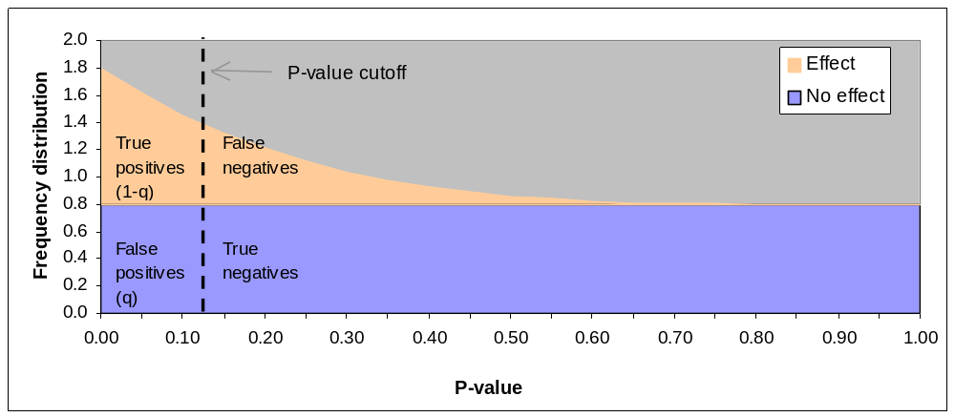
Using a p-value cut-off

Slide 16
Estimating FDR
In practice we will see both distributions mixed together.
We can use curve fitting to estimate what the p-value distribution for the two components (true negatives and positives) is.
From this, we can estimate the FDR for any p-value.
300
300
250
250
200
200
150
150
100
100
50
50
0.0
0
0
0.0
0.2
0.2
0.4
0.4
0.6
0.6
0.8
0.8
1.0
1.0

Slide 17
Estimating FDR (curve fitting)
Hedenfalk p_values with fitted Mixture Distribution (Uniform+Beta)
300
300
250
250
Frequency
200
200
150
150
100
100
50
50
0
0
0.0
0.0
0.2
0.2
0.4
0.4
0.6
0.6
0.8
0.8
1.0
1.0
p_value

Slide 18
Deciding which positives are true and which are false
You can’t do it using the current data.
You need to do more research

Slide 19
Estimating FDR (Genstat)
Use the procedure
fdrmixture [dist=beta]prob=p_value; FDR=heden_fdr
First put the p-values into a variate (here called p_value)
Create a new text window (File > New)
Type the above procedure command, then Run > Submit Line or Submit Selection
Result will be in a variate (here called heden_fdr, which can be copied to a spreadsheet.

Slide 20
Estimating FDR (Genstat)
fdrmixture [distrib=beta] prob=p_value; FDR=heden_fdr
Occasionally the estimation procedure ‘fails to converge’. The three common solutions are
Allow more iterations in the numerical process
Switch to a Gamma distribution for modeling the Ha p-values
Specify initial values for the three parameters, φ, A and B. φ estimates the proportion of Ho values. When this proportion is not close to the default of 0.9 there will be convergence problems. A and B are the parameters of the Beta or Gamma distribution.
fdrmixture [distribution=gamma; maxcycle=100; initial=!(0.8,0.2,2)]\ probabilities=p_value; FDR=heden_fdr
This Genstat procedure also estimates the False Rejection Rate, FRR, ie the probability of rejecting a gene that is a true positive, Pr(Ha|Do).
fdrmixture [distribution=beta] \
probabilities=p_value; FDR=heden_fdr; FRR=heden_frr.
See notes

Slide 21
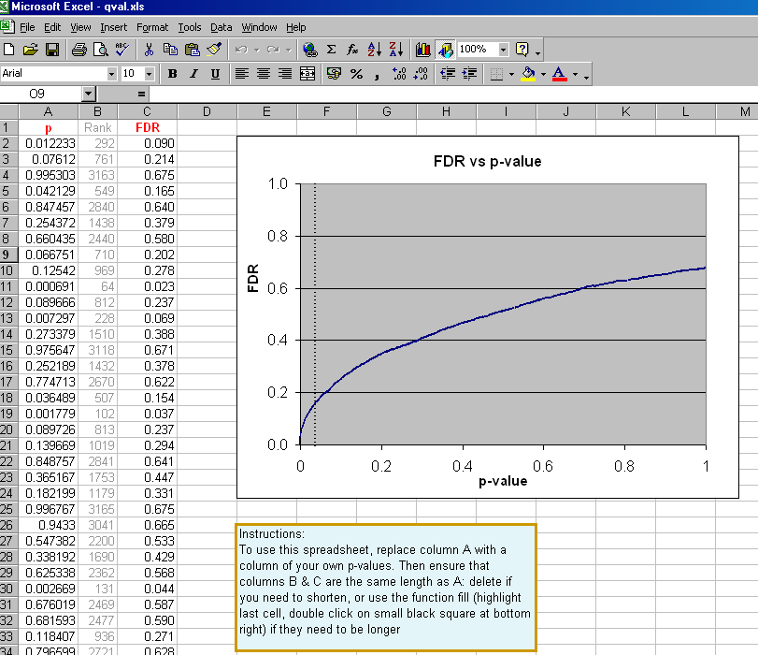
Estimating FDR (Excel)
Uses a different method. Appears to give similar results

Slide 22
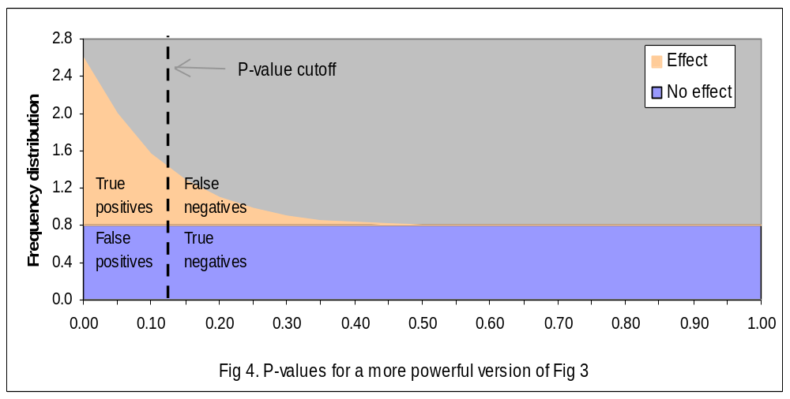
Effect of sample size
Bigger sample size

Slide 23
Design: sample size and power
Sample size is chosen when the experiment is designed (so this should have come first!)
Usual aim is to reduce false negatives
A bigger sample will not reduce the number of false positives.
However it will increase the number of true positives

Slide 24
Sample size & power
Three related quantities:
Size of effect important enough not to miss (relative to the random variation)
Power (e.g. 80%, 90%, 95%).
Sample size (n=?)

Slide 25
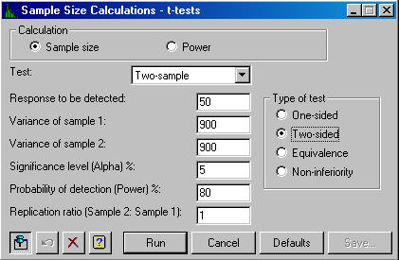
Power calculation: example
Require to detect change of 50% or more
Random variation is 30%
Want power of 80%
To detect a response of 50.00, at a two-sided significance level of 0.050 with a power of 0.800 using a two-sample t-test, requires a replication of 7 for each sample.

